Slide 1
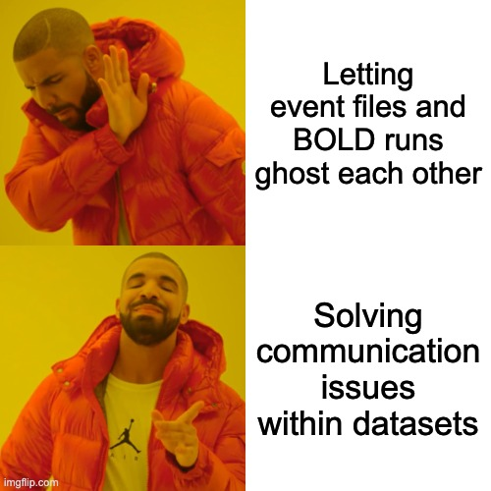

Slide 2
A Configurable QC Workflow
for Task-fMRI Data Readiness
Xuan (Chelsea) Chen • NTU-TW
BrainHack School Symposium 2026
Before analyzing brains, let’s make sure
the files have “communicated.”
Events
Behavior
Stimuli
Imaging
files
Config
file
QC
script
Report
+ WARNINGS

Slide 3
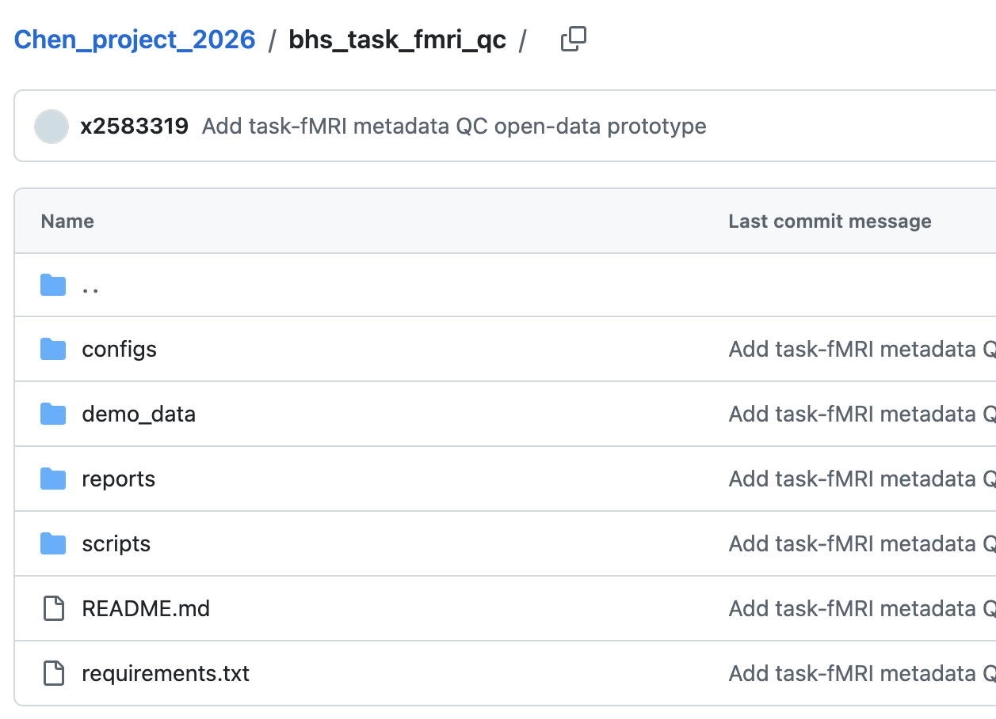
“Couples therapy” for task-fMRI files
Linking event metadata with
imaging-file structure
before deeper analysis!
A flexible workflow helps different datasets communicate clearly.
1. Introduce them! → Read event files and imaging-file listings
2. Check the relationship status… → Validate columns, file patterns, and event–BOLD matching
3. Document the drama :( → Write human-readable Markdown reports with warnings
- dataset-specific expectations
- documented results
- reusable QC logic

Slide 4
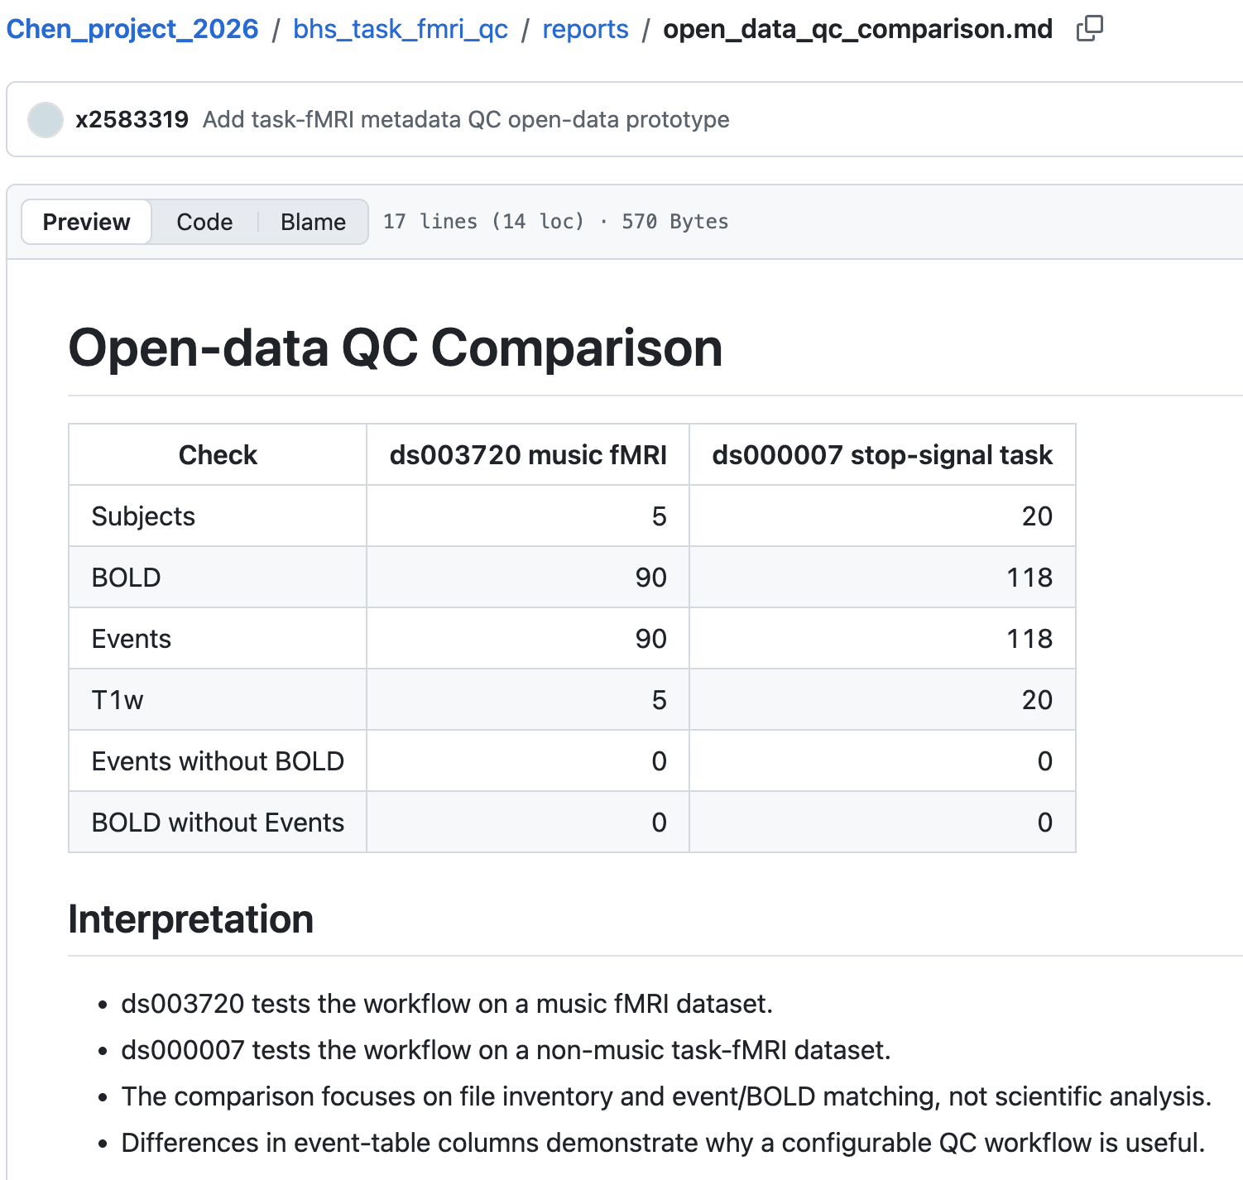
Two datasets + Same QC
One configurable file-inventory check across two different task-fMRI datasets.
Takeaway
Both datasets had 0 events without BOLD and 0 BOLD runs without events.

Slide 5
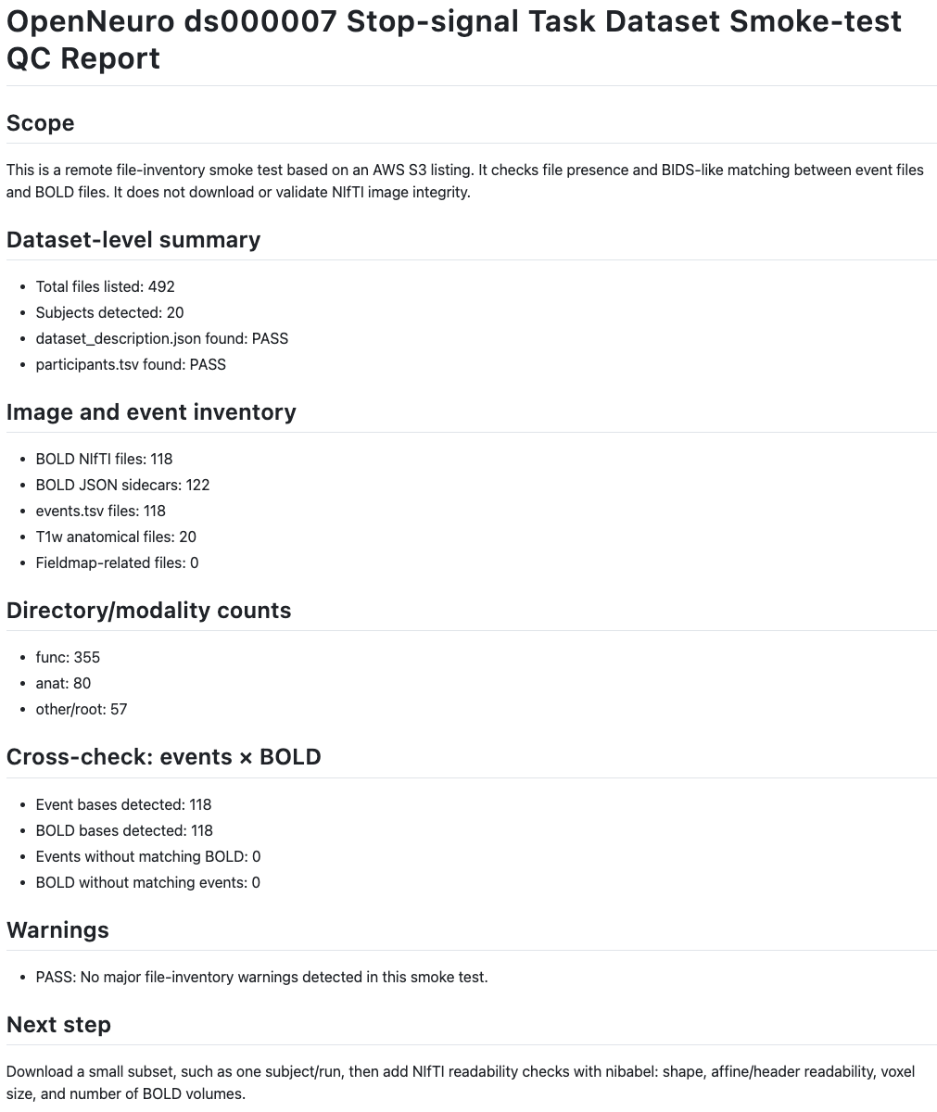
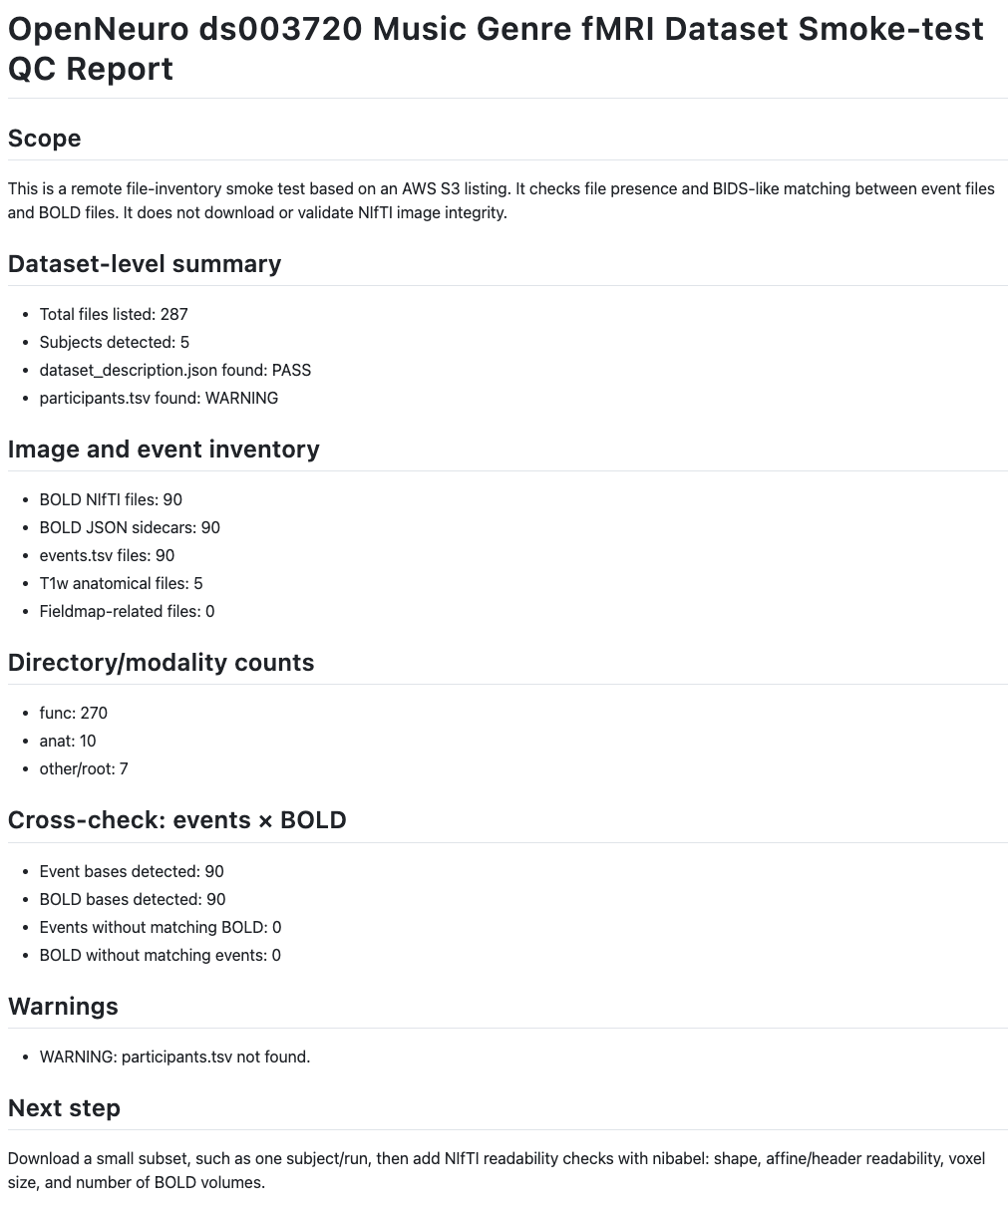
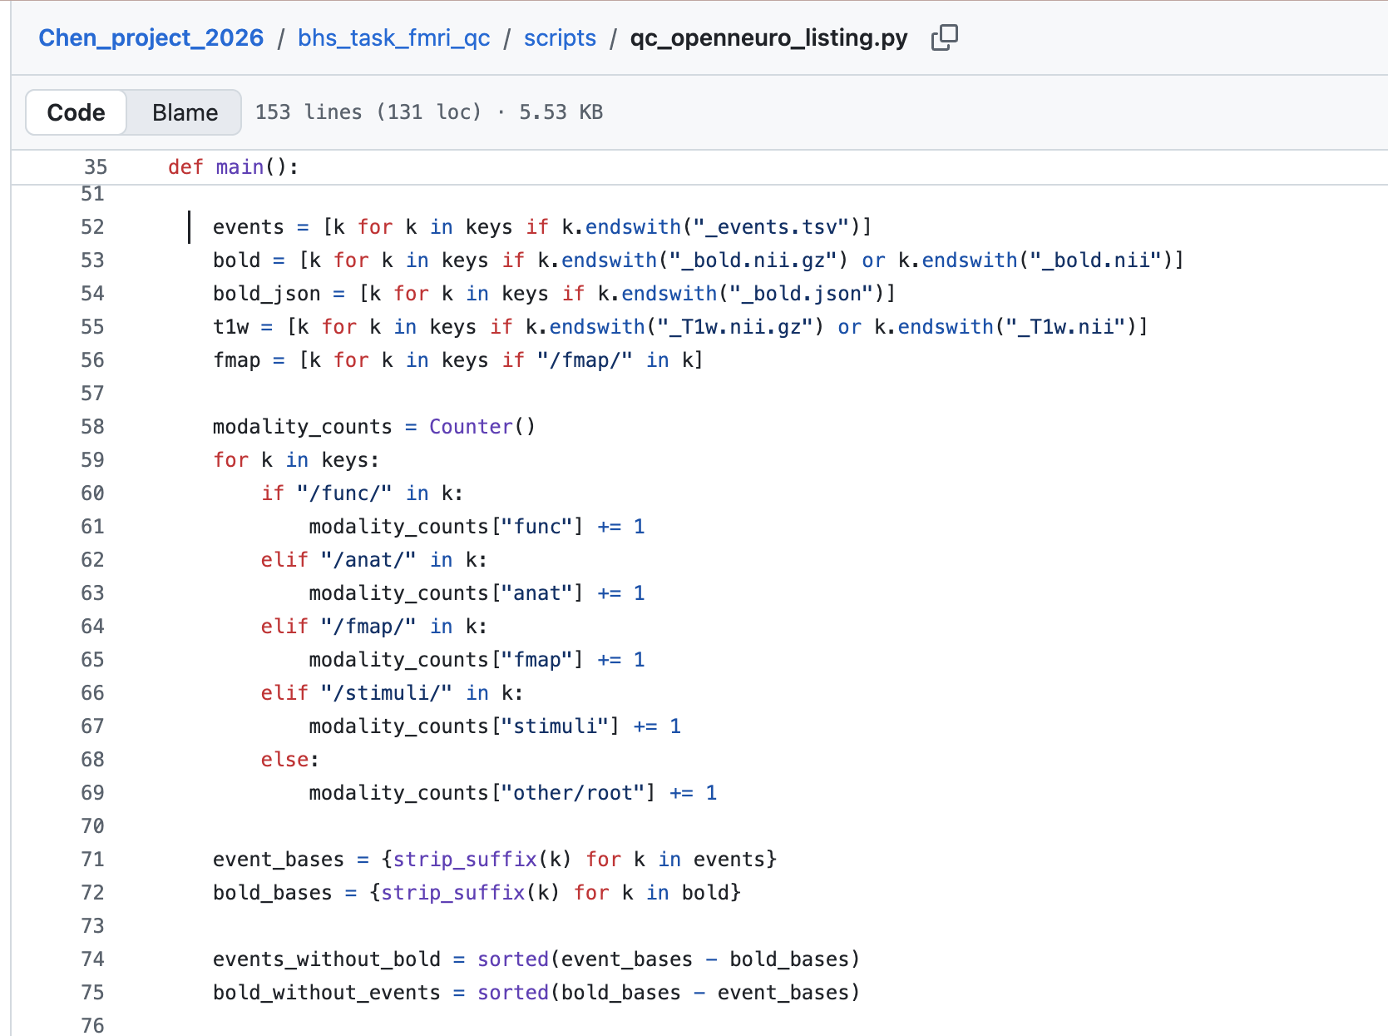
The couples therapist leaves “receipts.”
2. The receipt → Smoke tests
A reproducible readiness check before deeper analysis.
1. The therapist → Snapshots of the matching code
3. The status update → Relationship status:
☑ Communicating
☐ Ghosting
☐ “I thought that was the matching run”

Slide 6
THANK YOU!
TLDR:
I made a reusable check for task-fMRI files.
It checks that task-event files and brain-scan runs are properly matched before anyone analyses the brains. Because brains are complicated enough, but your filenames do not need to be.

